Slide 1
LC Districts project
final event:
“Transforming the Built Environment of our Cities”
Brussels 11th October 2022 side event in the frame of the European Week of Regions and Cities

Slide 2
LOW CARBON DISTRICTS
The Low Carbon Districts (LCDs) are areas with homogeneous characteristics for which public and private entities propose integrated management interventions in the common interest of social, cultural and economic development and energy-enhancing environmental of the urban and territorial context of reference. To achieve Low Carbon Districts, intelligent energy management and the use of renewable energy in public infrastructure, including public buildings, and in the housing, sector is required. An evaluation tool is needed to measure the scope of these strategies.

Slide 3
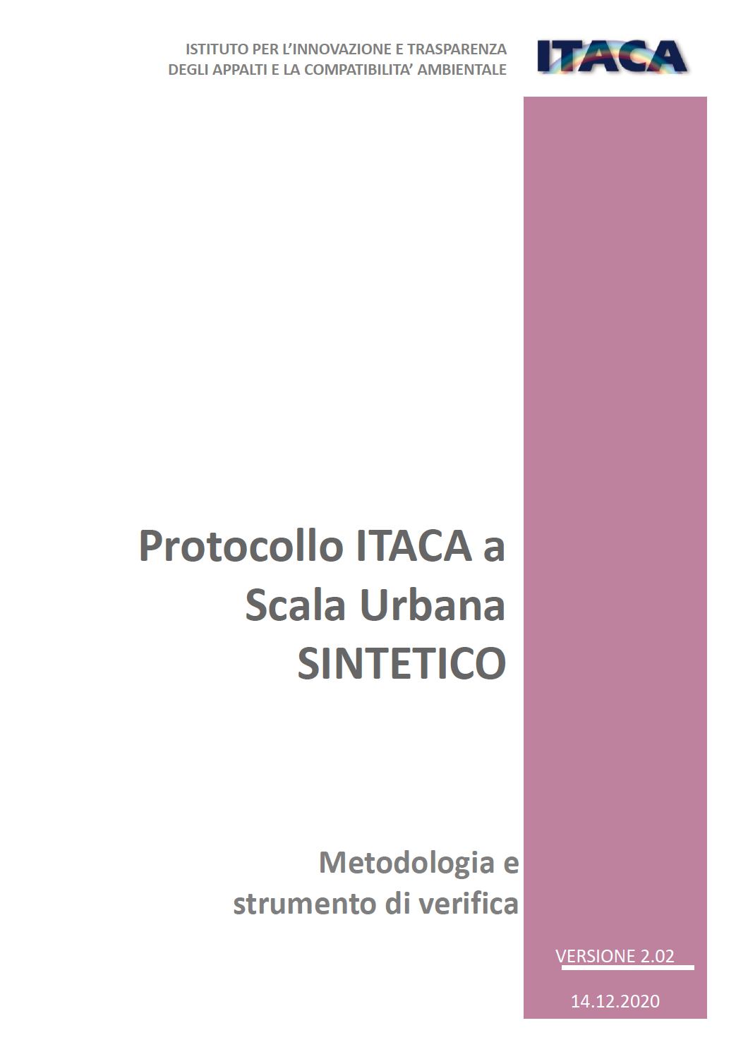
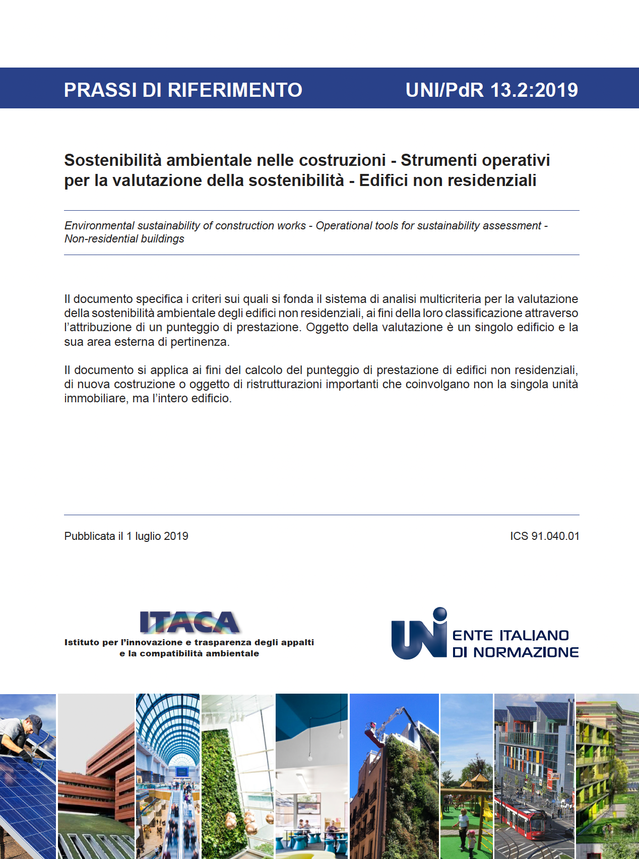
ACTION OBJECTS
The Marche Region's action plan is aimed to design a Low Carbon District by applying in a combined way the ITACA Protocols (UNI PdR 13:2019 Practice) for buildings and at URBAN SCALE that certifies the territorial area pertaining to the building.

Slide 4
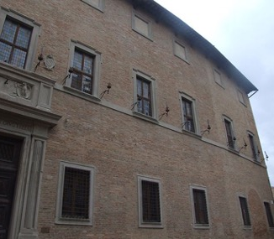
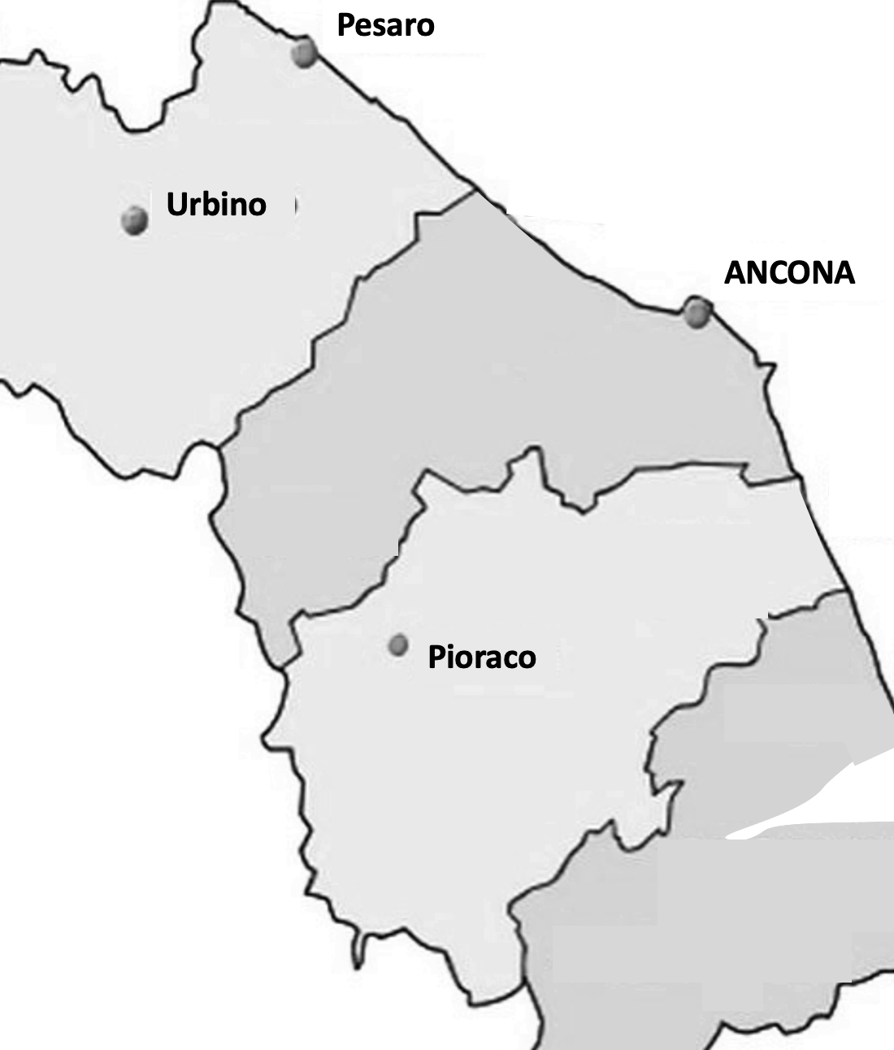
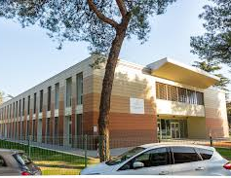
The action will be implemented in 3 territories of the Marche Region that represent three different types of morphology and urban structure in which it is interesting to implement a low-carbon district design methodology:
-A coastal, tourist and high-density urban municipality (Municipality of Pesaro);
-A valuable historical-cultural centre, UNESCO heritage site (Municipality of Urbino).
-A small mountain town in areas affected by the earthquake (Municipality of Pioraco);

Slide 5
HOW DO WE TRY TO REDUCE
C
2
?
The purpose is to determine a monitoring indicator suitable for providing the prerequisites to measure the energy-environmental benefits of the action to assess how much a "certified low-carbon district," with demonstrated fully certified high-energy environmental performance, could contribute to a territorial low-carbon policy.
To support the choice of the best-performing performance index, the criterion of the ITACA Protocol C.1.2. will be considered, according to which the value of the annual equivalent CO2 produced for the operation of the reference building (DM minimum requirements).
The calculation of C0₂ equivalent emissions will have to be done for all buildings where at least one of the cooling, heating and DHW production services are present.

Slide 6
THE POLICY INSTRUMENT
The policy instrument to be improved identified in the application form was the Marche Region Growth & Jobs ERDF Regional Operational Programme 2014/2020 2014IT16RFOP013 which refers to the programming that has now come to an end (European Structural Founds 2021 – 2027).
The PEAR, Regional Environmental Energy Plan, is the regional environmental energy management program in which the Marche Region has identified the strategies to pursue energy transition.
The new PEAR will affect the next Regional Operational Program POR-FESR 2021/2027, and the resulting results of the action will be incorporated in this political instrument to launch more targeted calls aimed at promoting "sustainable districts".
Marche Region (Regional Law n. 250 of 08/03/2021) has promoted the REGIONAL STRATEGY OF SUSTAINABLE DEVELOPMENT (SRSvS) in which the possibility of designing a low carbon district through the application of a sustainable certification protocol.
Marche Region is finalizing the process for a law proposal that governs the planning and interventions of the Region and local authorities in the field of energy, in accordance with Article 30 of Legislative Decree 31 March 1998, n. 112, article 117 of the Constitution, European and national legislation on energy and climate change in order to facilitate the transition to low-carbon urban districts.

Slide 7
Thanks for the ATTENTION
Brussels 11th October 2022 side event in the frame of the European Week of Regions and Cities

